Slide 1

UCB Data Analysis Bootcamp Group Project 1 Dhwani Shah, Eduardo Gonzales, Johnathan Tran, Justin Nolan July 2024

Slide 2


Crime Chronicles
Scope analysis of crime rate in California based on the changes in the rate of inflation.

Slide 3
Research Questions
How have crime rates in California changed from 1998 to 2023?
What are the long-term trends in different types of crime (e.g., violent crimes, property crimes) over this 25-year period?
Is there a correlation between annual inflation rates and overall crime rates in California over the past 25 years?
How does inflation impact different types of crime (e.g., theft, burglary, assault) over this period?

Slide 4
Data Source:

Slide 5
Data Cleanup and Exploration:

Slide 6
Data Analysis :
Refer to the Jupyter Notebook at :

Slide 7
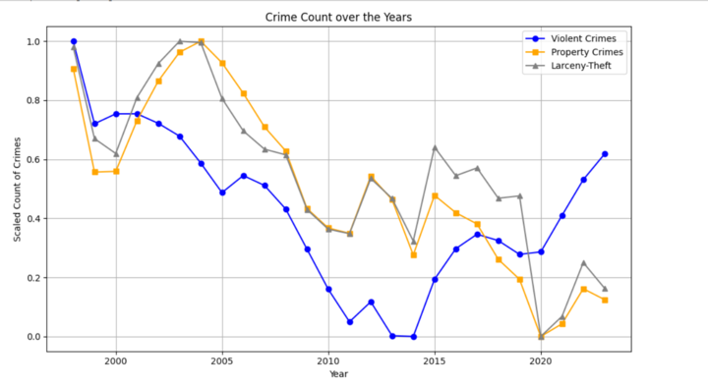
HOW HAVE CRIME RATES IN CALIFORNIA CHANGED FROM 1998 TO 2023 ?
Summary Analysis:
It shows the crime count in California from 1998 to 2023. The y-axis is the scaled count of crimes, and the x-axis is the year. The three lines represent violent crimes, property crimes, and larceny-theft.
General Trends:
From 2000 to 2005, the crime rate in California increased for all three categories. From 2005 to 2010, the crime rate decreased for all three categories. From 2010 to 2015, the crime rate increased for violent crimes and property crimes, but decreased for larceny-theft. From 2015 to 2020, the crime rate decreased for all three categories.
Conclusion:
Overall, the crime rate in California has decreased from 1998 to 2023. However, there are some fluctuations in the data. For example, the crime rate increased from 2000 to 2005, then decreased from 2005 to 2010. This could be due to a number of factors, such as changes in the economy, law enforcement, or demographics.

Slide 8
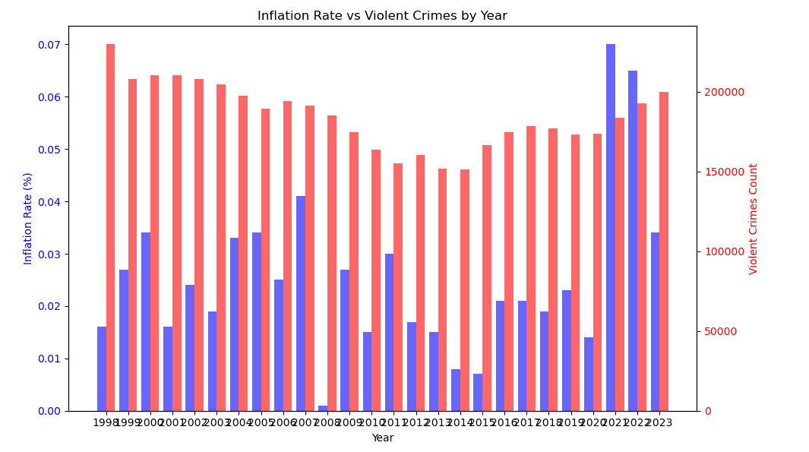
Is there a correlation between annual inflation rates and violent crime rates in California over the past 25 years?
Summary Analysis of Inflation Rate vs. Violent Crimes by Year (1998-2023)
The bar chart illustrates the relationship between the inflation rate and the number of violent crimes in the United States from 1998 to 2023. Key observations include:
General Trends:
Inflation Rate: High in the late 1990s, decreasing in the early 2000s, and relatively stable with a significant increase in the early 2020s.
Violent Crimes: Decreased from the late 1990s to the mid-2010s, then increased notably in the early 2020s.
Late 1990s to Early 2000s: High inflation rates coincide with high violent crime rates, which then decline as inflation decreases.
Mid-2000s to Early 2010s: Stable, lower inflation rates accompany a continued decline in violent crimes.
Mid-2010s to Early 2020s: Violent crimes remain low until a spike in the early 2020s, concurrent with rising inflation rates.
Early 2020s: A significant increase in both inflation and violent crimes suggests a potential direct correlation.
Conclusion
The data indicates a complex relationship between inflation and violent crime rates, with possible inverse correlation in earlier years and a direct correlation in recent years. Further analysis of additional economic variables is needed to fully understand this relationship.

Slide 9
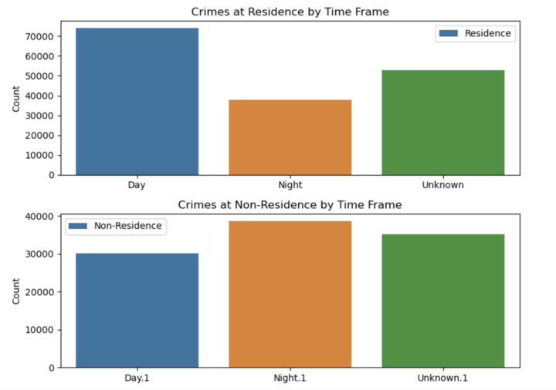
Is there a significant difference in the number of crimes at residences and non-residences during the day and night?

Slide 11
Conclusion:

Slide 12
Reference :

Slide 13
Thank-You

